Slide 1
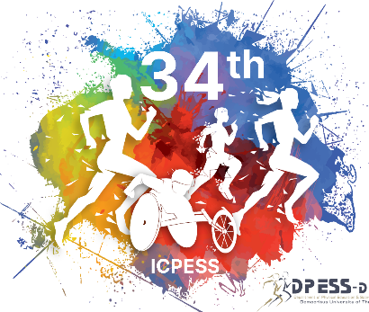
PEDOMETER DETERMINED PHYSICAL ACTIVITY, BONE MINERAL CONTENT AND DENSITY OF PREMENARCHEAL GIRLS
Kambas, A., Leontsini, D., Chatzinikolaou, A., Avloniti, A., Stambouis, Th., Gounelas, G., Karagiannopoulou, S., Protopapa, M., Pontidis, Th., Mavropalias, G., Giannakidou, D., Ermidis, G.
School of Physical Education and Sport Science, Democritus University of Thrace, Komotini, Greece

Slide 2
Introduction
Childhood is a unique period of human life due to the rapid growth rates and the special needs that exist. Children have much higher nutrient requirements compared to adult and exhibit high growth rates of bone tissue, making this stage of life important for improving bones condition and increase peak bone mass as a factor that can compensate osteoporosis and bone fractures (Hind & Burrows, 2007). Increased physical activity (PA) increases bone density and composition in children of school age in hole body, lumbar spine and femoral neck bone area (Meyer et al, 2011), promoting bone health and preventing osteoporosis later in life (Baxter-Jones et. al., 2008). However, current literature lacks comprehensive data on physical activity's contribution to bone mineral content and density in prepubescent girls.

Slide 3
Methods
The sample consists of 60 girls (means ± SD), age 11.00±.93 yr, weight 36.52±9.7kg., height 1.44±.07cm. PA was assessed using the piezoelectric Omron Walking style pro HJ-720IT-E2 pedometer worn for 10 consecutive days. Bone mineral content and density parameters were measured with dual-energy densitometry (Lunar DPX NT). A one-way Anova with adjustment for weight was conducted to check the effects of PA on bone parameters. A Sidak test was applied for post-hoc comparisons.

Slide 4
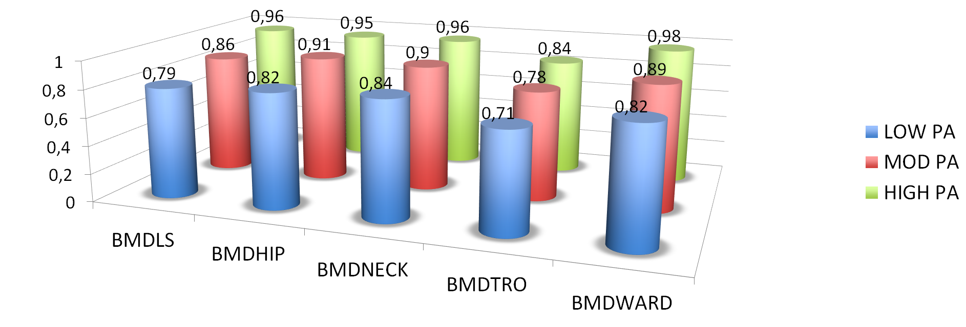
Results
A visual-binning procedure was used to classify step counts into categories, resulting three groups
(low: 5,800-8,531 steps/day; mod: 8,561-16,000 steps/day and high: 17,460-21,094 steps/day).
Results revealed significant effects of PA on BMDLS (F=7.17, p<.005), BMDHIP (F=8.19, p<.001),
BMDNECK (F=5.87, p<.005), BMDTRO (F=7.45, P,.001) and BMDWARD (F=13.38, p<.001).
Post-hoc tests showed that in all comparisons the "high" PA group demonstrated better values
than the other two groups (p<.005).

Slide 5
Discussion
A great determinant of BMD in girls is puberty (Annemieke et.al. 1997), and physical activity appears to be an important determinant too. The results of this study suggest that PA (steps/day) might affect bone mineral content and density in LS, HIP, NECK, and TRO areas. More specifically, it appears that prepubertal girls demonstrating more than 17,000 steps/day benefited more than their counterparts with less of 16,000 steps/day. These differences were translated to higher bone strength. Nevertheless there is a need to translate steps-data in order to determine their relationship to PA intensity.
Request literature list by authors

